Slide 1
GRADUATED ASSIGNMENT FOR MULTI-GRAPH MATCHING
Arber Aga

Slide 2
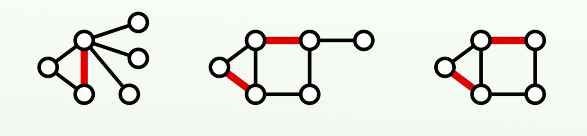
What is graph matching
Graph matching is the problem of finding a similarity between graphs
Continuous relaxation
Tree search algorithms
Deep graph matching

Slide 3
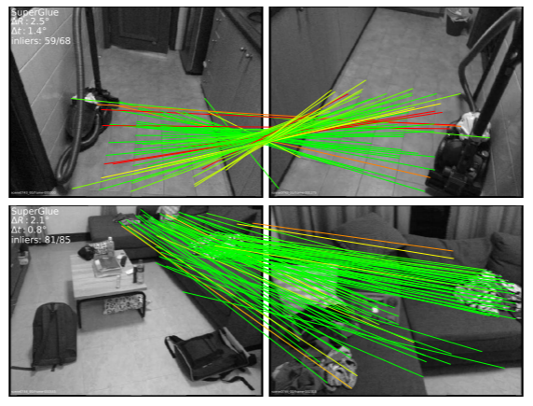
APPLICATION IN COMPUTER VISION
Graph matching algorithms can encode geometric relationships between feature points.
Applications
Face recognition
Action recognition
Duplicate detection

Slide 4
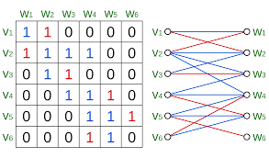
Defining our problem
Quadratic Assignment Problem (QAP) – A generalization of the ‘traveling salesman problem’
Sinkhorn algorithm - A simple iterative method to approach the double stochastic matrix is to alternately rescale all rows and all columns of a matrix to sum to 1
The Hungarian matching algorithm is a algorithm that can be used to find maximum-weight matchings in bipartite graphs, which is sometimes called the assignment problem

Slide 5
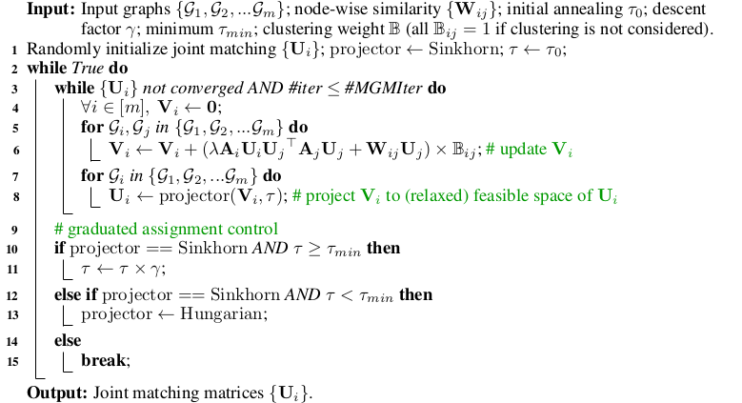

Slide 6
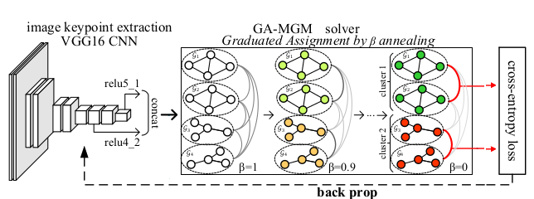

Slide 7
APPROACH
Iteratively solving the first-order Taylor expansion of the Multi-Graph QAP.
Before iteration
Initialize matching matrix using similarity heuristic
Each iteration
Update matching matrix using Sinkhorn
Final iteration
Update matching matrix using Hungarian

Slide 8
RESEARCH QUESTION
How robust is state of the art graph matching algorithms to sample changes?
Hypothesis
Larger sample sizes lead to higher testing accuracy
This will translate equally to other models

Slide 9
EXPERIMENTS

Slide 10
Experiment validation
Averages of 3 runs
Each run performed on the same machine after reset

Slide 11
GANN
Number of samples | F1 Score | Variance | Time (m)
20 | 88.87% | 12.98% | 1.42
30 | 92.85% | 10.29% | 1.15

Slide 12
GANN
Number of samples | F1 Score | Car | Wine bottle | Motorbike | Face | Duck
20 | 88.87% | 60.67% | 90.64% | 94.00% | 100% | 98.67%
30 | 92.85% | 72.67% | 95.08% | 100% | 100% | 96.50%

Slide 13
CIE
Number of samples | F1 Score | Variance | Time (h)
20 | 88.61% | 15.67% | 2.32
30 | 10.25% | 10.39% | 2.30

Slide 14
Conclusion
Further workConclusion
The experiments didn’t fully meet our expectations
Try a larger sample size
Change the size of query/target graphs

